Slide 1
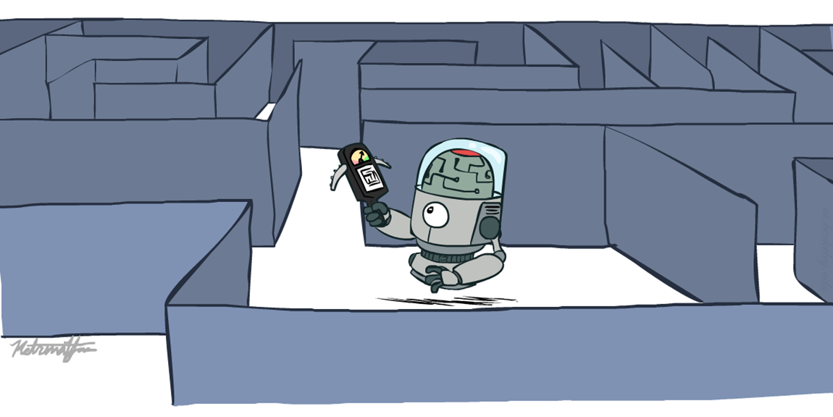
Informed Search
Heuristics Search

Slide 2
Introduction
Heuristic search is a problem-solving technique used in artificial intelligence to efficiently explore a search space and find the optimal or near-optimal solution. It involves using heuristic functions or rules of thumb to guide the search algorithm towards the most promising branches of the search space.
Heuristic search is widely used in various applications, including game playing, route planning, scheduling, and robotics, where the search space is too large to explore exhaustively.

Slide 3
What are Heuristics?
Heuristics are know-hows obtained through a lot of experiences.
Heuristics often enable us to make decisions quickly without thinking deeply about the reasons.
The more experiences we have, the better the heuristics will be.

Slide 4
When Heuristics are used?
AI problem solvers employ heuristics in two basic situations:
A problem may not have an exact solution because of inherent ambiguities in the problem statement or available data.
  Medical diagnosis: Given symptoms may have several possible causes;
  Doctors use heuristics to choose the most likely diagnosis and formulate a treatment plan.
A problem may have an exact solution, but the computational cost of finding it may be prohibitive.
  Chess: state space growth is combinatorically explosive, with the number of possible states increasing with the depth of the search.
  Heuristics attack this complexity by guiding the search along the most “promising” path through the space.

Slide 5
Heuristic function
The heuristic function is a function that estimates the distance or cost from a particular state to the goal state. It helps the search algorithm to evaluate the desirability of a particular node or path based on the estimated distance or cost to the goal state.
Heuristic search algorithms include A* search, iterative deepening A*, greedy search, and hill climbing. These algorithms differ in the way they use the heuristic function to guide the search process.

Slide 6
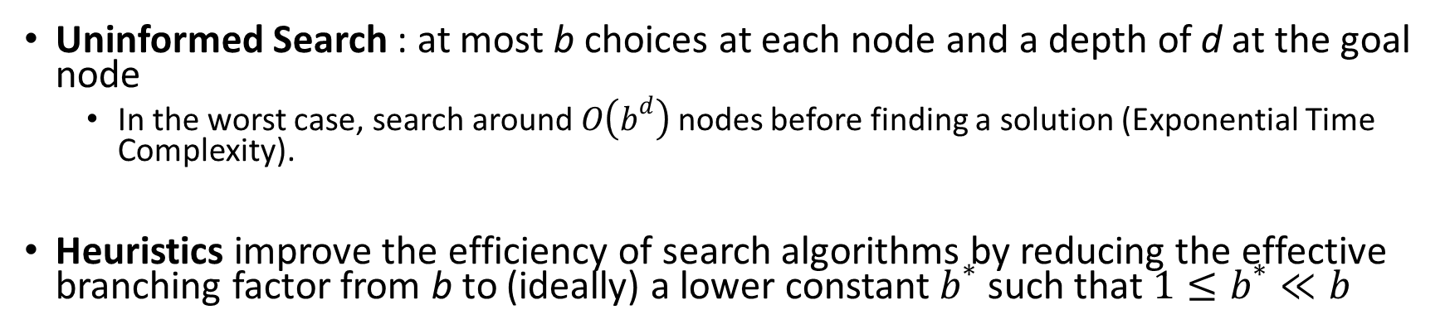
Why heuristic functions work?
Uninformed Search : at most b choices at each node and a depth of d at the goal node
  In the worst case, search around $O\left(b^{d}\right)$ nodes before finding a solution (Exponential Time Complexity).
Heuristics improve the efficiency of search algorithms by reducing the effective branching factor from b to (ideally) a lower constant $b^{∗}$ such that$1≤b^{∗}≪b$
Guide search towards the goal instead of all over the place
Start
Goal
Start
Goal
Informed
Uninformed

Slide 7
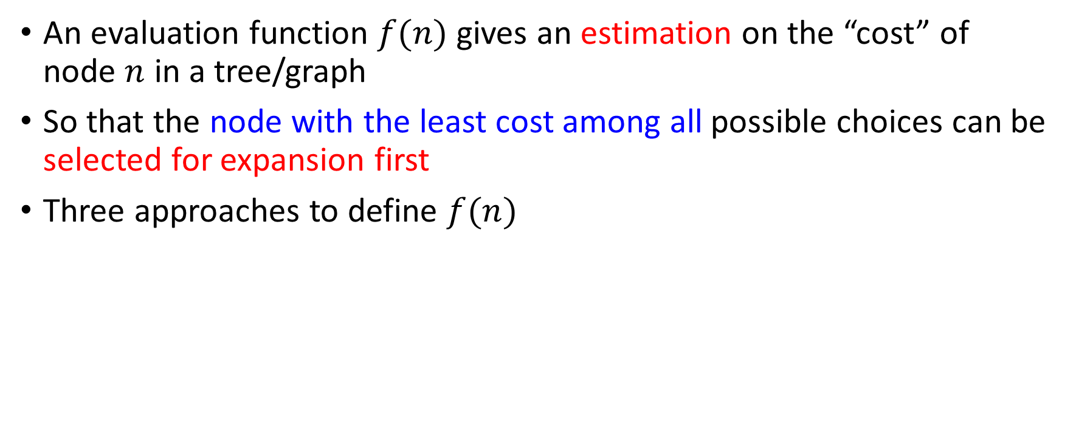
Evaluation Function
An evaluation function $f(n)$ gives an estimation on the “cost” of node $n$ in a tree/graph
So that the node with the least cost among all possible choices can be selected for expansion first
Three approaches to define $f(n)$

Slide 8
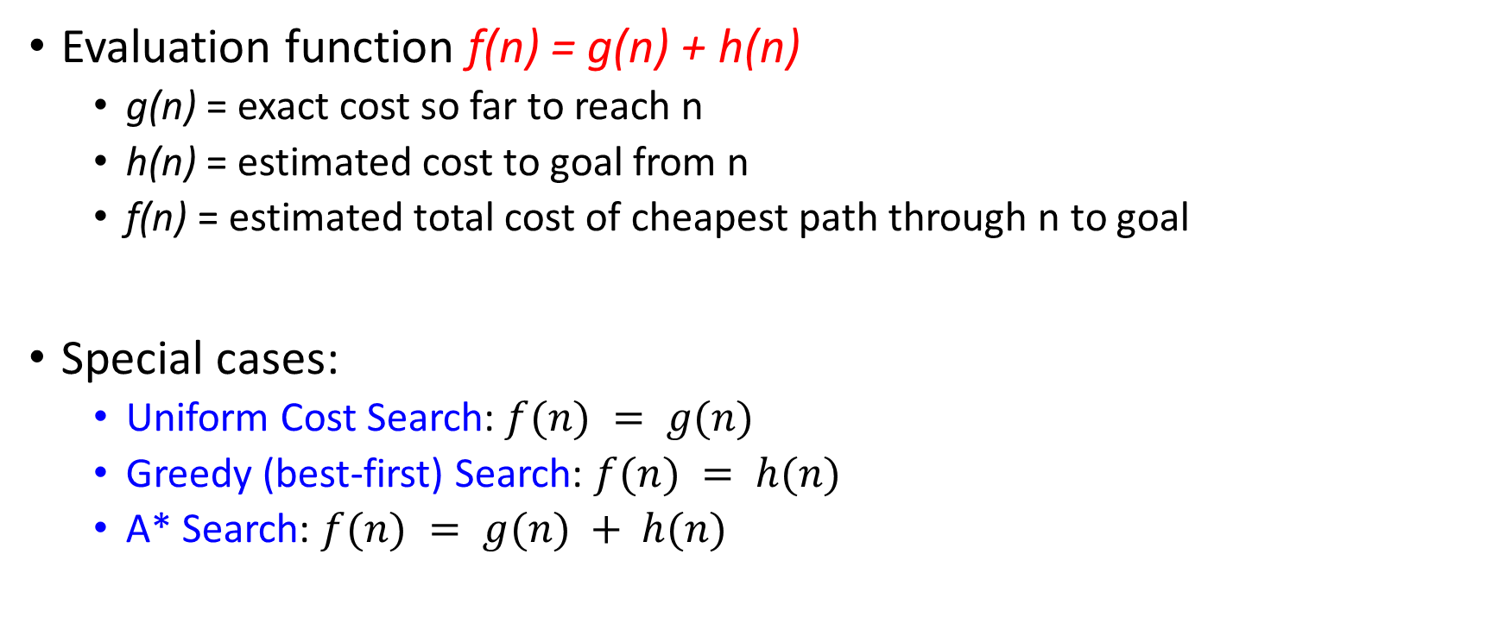
Evaluation / Heuristic Function
Evaluation function f(n) = g(n) + h(n)
  g(n) = exact cost so far to reach n
  h(n) = estimated cost to goal from n
  f(n) = estimated total cost of cheapest path through n to goal
Special cases:
  Uniform Cost Search: $f(n) = g(n)$
  Greedy (best-first) Search: $f(n) = h(n)$
  A* Search: $f(n) = g(n) + h(n)$

Slide 9
How it works?
Idea: use heuristic function for each node
  that estimates desirability
Expands most desirable unexpanded node
Implementation:
  fringe is a queue sorted in order of desirability
Special cases:
  Uniform Cost Search (uninformed)
  Greedy (best-first) Search (informed)
  A* Search (informed)

Slide 10
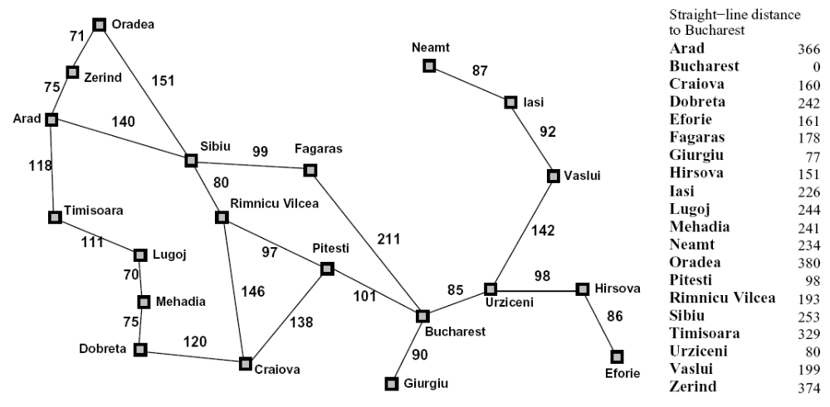
Example: Heuristic Function
h(x)

Slide 11
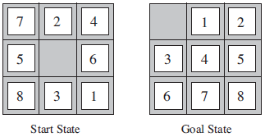
8–Puzzle: Heuristics?
h1: The number of misplaced tiles (squares with number).
h2: The sum of the distances of the tiles from their goal positions.

Slide 12
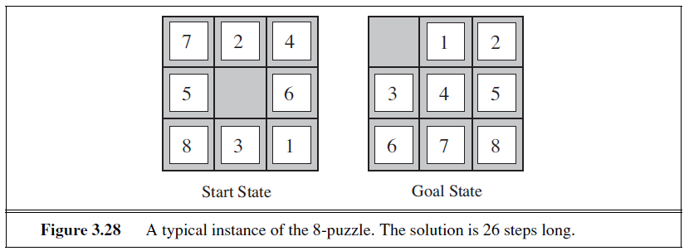
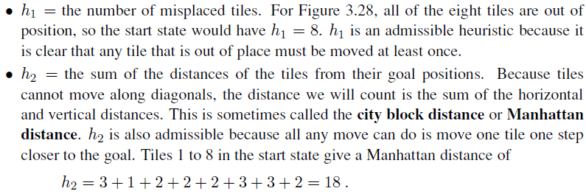

Slide 13
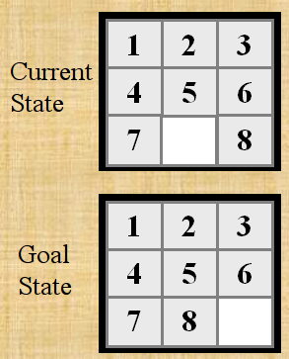

Slide 14
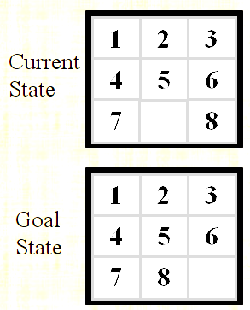
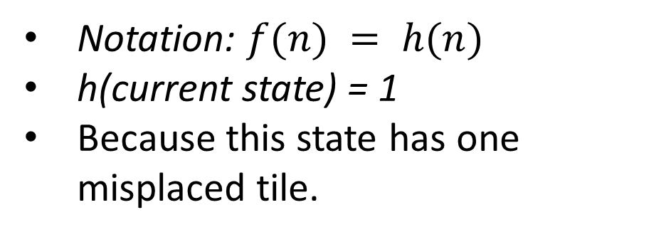
h1: The number of misplaced tiles (not including the blank)
Notation: $f(n) = h(n)$
h(current state) = 1
Because this state has one misplaced tile.
Only “8” is misplaced
So the heuristic function evaluates to 1.
The heuristic is telling us, that it thinks a solution might be available in just 1 more move.

Slide 15
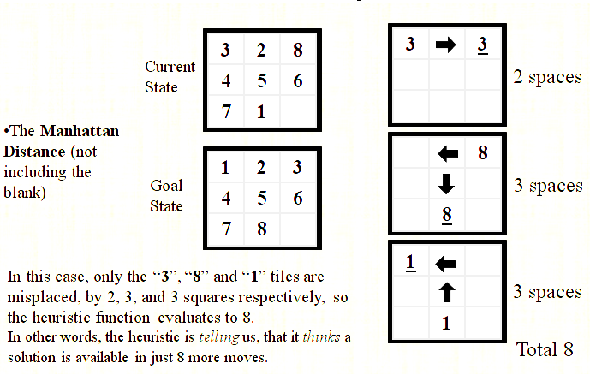
h2: The sum of the distances of tiles from goal positions
Notation: $f(n) = h(n)$, h(current state) = 8

Slide 16
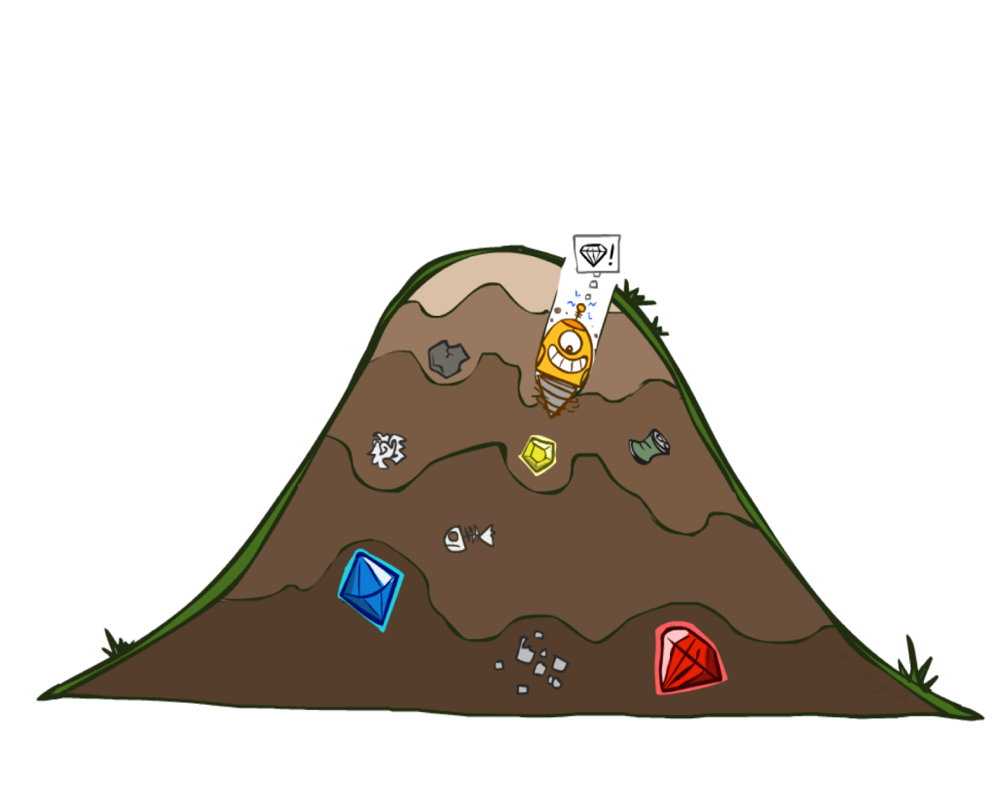
Greedy Best First Search
eval-fn: $f(n) = h(n)$

Slide 17
What is greedy best first search?
Greedy best-first search is a heuristic search algorithm used in artificial intelligence to find the shortest path between two nodes in a graph or tree. It is a variation of best-first search that uses a heuristic function to determine which node to expand next.

Slide 18
How Greedy search works?
In greedy best-first search, at each step, the algorithm selects the node that appears to be closest to the goal based on the heuristic function. The heuristic function estimates the distance between the current node and the goal, and the algorithm chooses the node with the lowest estimated distance as the next node to explore.

Slide 19
Greedy (Best-First) Search
Idea: Expand node with the smallest estimated cost to reach the goal.
Use heuristic function f(n) = h(n)
Best-first search tries to expand the node that is closest to the goal, on the grounds that this is likely to lead to a solution quickly.
Choose path with low heuristic value

Slide 20
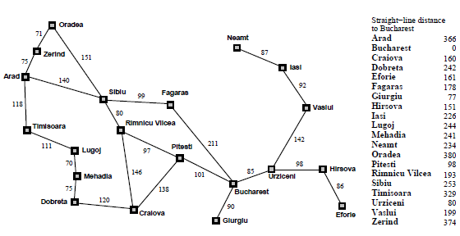

Slide 21

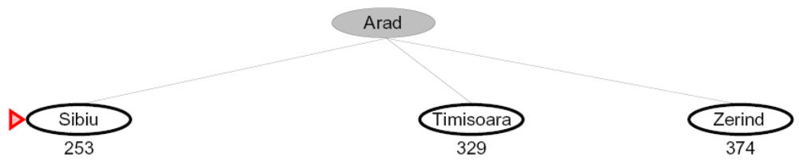
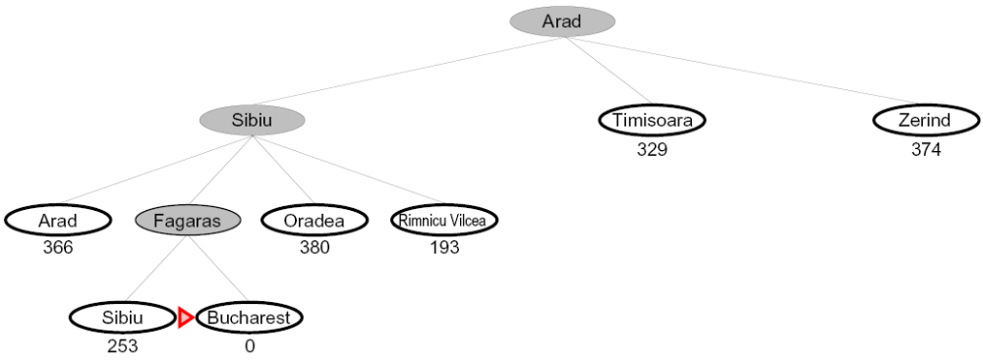
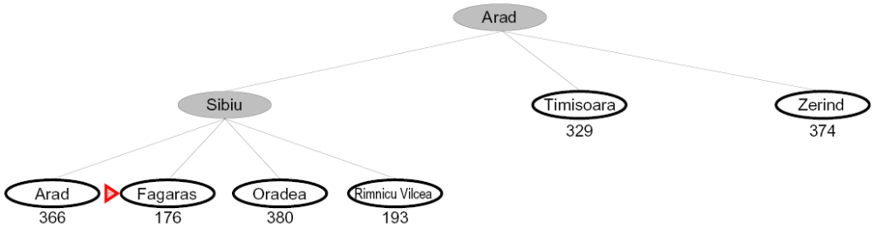
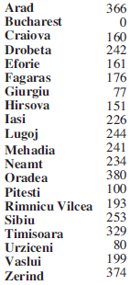
Greedy Search
Expand the node that seems closest…
What can go wrong?

Slide 22
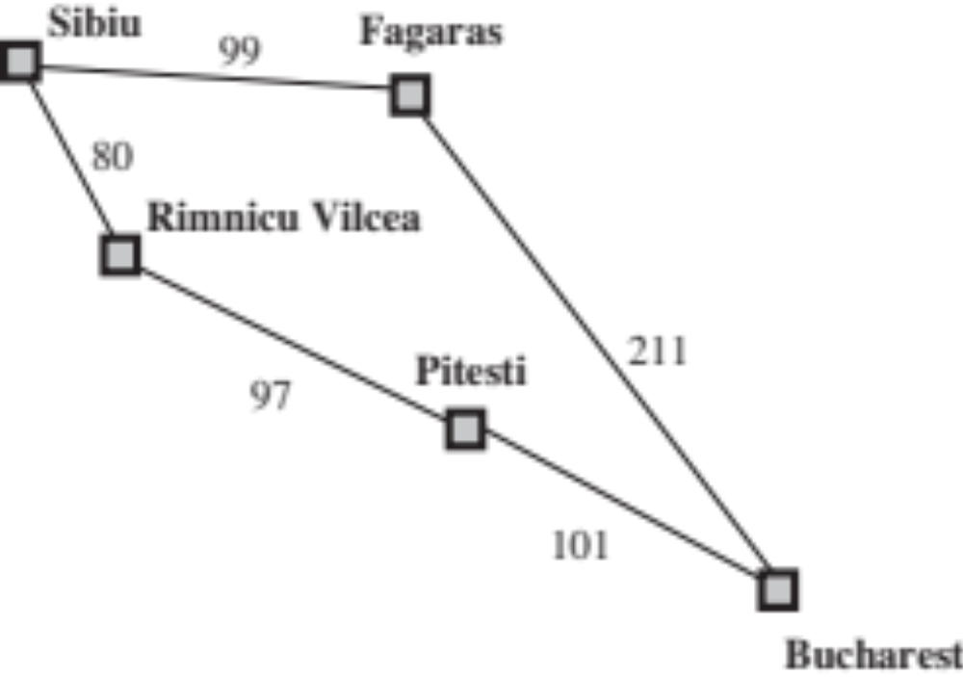
Greedy Search
Expand the node that seems closest…(order frontier by h)
What can possibly go wrong?
Sibiu-Fagaras-Bucharest =
99+211 = 310
Sibiu-Rimnicu Vilcea-Pitesti-Bucharest =
80+97+101 = 278
h= 253
h=176
h=193
1000000
h=100
h=0

Slide 23
Greedy Search
b
…
Strategy: expand a node that you think is closest to a goal state
  Heuristic: estimate of distance to nearest goal for each state
A common case:
  Best-first takes you straight to the (wrong) goal
Worst-case: like a badly-guided DFS
b
…
Notes:
For any search problem, you know the goal. Now, you have an idea of how far away you are from the goal.

Slide 24
Best first search pseduocode
Best-First-Search(Graph g, Node start)
1) Create an empty PriorityQueue
PriorityQueue pq;
2) Insert "start" in pq.
pq.insert(start)
3) Until PriorityQueue is empty
u = PriorityQueue.DeleteMin
If u is the goal
Exit
Else
Foreach neighbor v of u
If v "Unvisited"
Mark v "Visited"
pq.insert(v)
Mark u "Examined"
End procedure

Slide 25
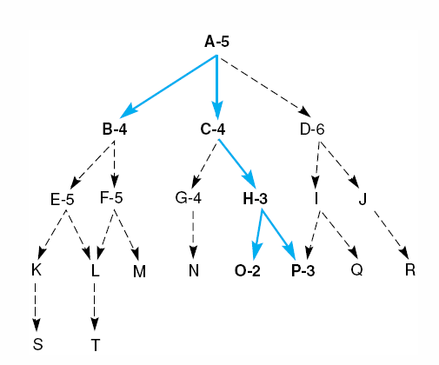
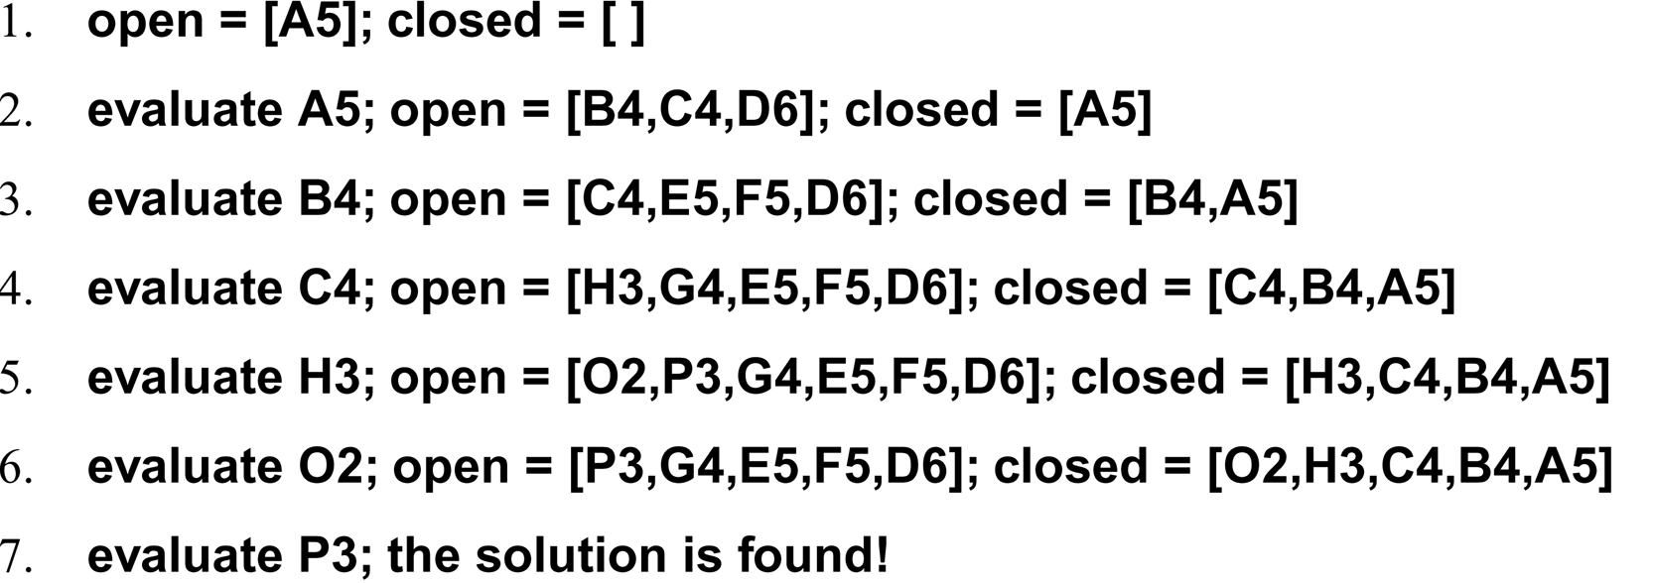
Best First Search

Slide 26
Greedy Search
State | Heuristic: h(n)
A | 366
B | 374
C | 329
D | 244
E | 253
F | 178
G | 193
H | 98
I | 0
Start
A
75
118
140
B
C
111
E
D
80
99
G
F
97
H
211
101
I
Goal
f(n) = h (n) = straight-line distance heuristic

Slide 27
Greedy Search: Tree Search
State | Heuristic: h(n)
A | 366
B | 374
C | 329
D | 244
E | 253
F | 178
G | 193
H | 98
I | 0
Start
A

Slide 28
Greedy Search: Tree Search
State | Heuristic: h(n)
A | 366
B | 374
C | 329
D | 244
E | 253
F | 178
G | 193
H | 98
I | 0
Start
A
75
118
[329]
140
[374]
B
C
[253]
E

Slide 29
Greedy Search: Tree Search
State | Heuristic: h(n)
A | 366
B | 374
C | 329
D | 244
E | 253
F | 178
G | 193
H | 98
I | 0
Start
A
75
118
[329]
140
[374]
B
C
[253]
E
80
99
[193]
[178]
G
F
[366]
A

Slide 30
Greedy Search: Tree Search
State | Heuristic: h(n)
A | 366
B | 374
C | 329
D | 244
E | 253
F | 178
G | 193
H | 98
I | 0
Start
A
75
118
[329]
140
[374]
B
C
[253]
E
80
99
[193]
[178]
G
F
[366]
A
211
[253]
I
[0]
E
Goal

Slide 31
Greedy Search: Tree Search
State | Heuristic: h(n)
A | 366
B | 374
C | 329
D | 244
E | 253
F | 178
G | 193
H | 98
I | 0
Start
A
75
118
[329]
140
[374]
B
C
[253]
E
80
99
[193]
[178]
G
F
[366]
A
211
[253]
I
[0]
E
Path cost(A-E-F-I) = 253 + 178 + 0 = 431
dist(A-E-F-I) = 140 + 99 + 211 = 450
Goal

Slide 32
Greedy Search: Optimal?
State | Heuristic: h(n)
A | 366
B | 374
C | 329
D | 244
E | 253
F | 178
G | 193
H | 98
I | 0
Start
A
75
118
140
B
C
111
E
D
80
99
G
F
97
H
211
101
I
Goal
f(n) = h (n) = straight-line distance heuristic
dist(A-E-G-H-I) =140+80+97+101=418
Not optimal!

Slide 33
Greedy Search: Complete ?
State | Heuristic: h(n)
A | 366
B | 374
** C | 250
D | 244
E | 253
F | 178
G | 193
H | 98
I | 0
Start
A
75
118
140
B
C
111
E
D
80
99
G
F
97
H
211
101
I
Goal
f(n) = h (n) = straight-line distance heuristic

Slide 34
Greedy Search: Tree Search
Start
A

Slide 35
Greedy Search: Tree Search
Start
A
75
118
[250]
140
[374]
B
C
[253]
E

Slide 36
Greedy Search: Tree Search
Start
A
75
118
[250]
140
[374]
B
C
[253]
E
111
[244]
D

Slide 37
Greedy Search: Tree Search
Start
A
75
118
[250]
140
[374]
B
C
[253]
E
111
[244]
D
Infinite Branch !
[250]
C

Slide 38
Greedy Search: Tree Search
Start
A
75
118
[250]
140
[374]
B
C
[253]
E
111
[244]
D
Infinite Branch !
[250]
C
[244]
D

Slide 39
Greedy Search: Tree Search
Start
A
75
118
[250]
140
[374]
B
C
[253]
E
111
[244]
D
Infinite Branch !
[250]
C
Even Incomplete in finite state space much like depth first search
(Complete in finite space with repeated-state checking)
[244]
D

Slide 40
Greedy Search: Time and Space Complexity ?
Start
Greedy search is not optimal.
Greedy search is incomplete
In the worst case, the Time and Space Complexity of Greedy Search are both O(b^{m})
Where b is the branching factor and m the maximum path length
A
75
118
140
B
C
111
E
D
80
99
G
F
97
H
211
101
I
Goal

Slide 41
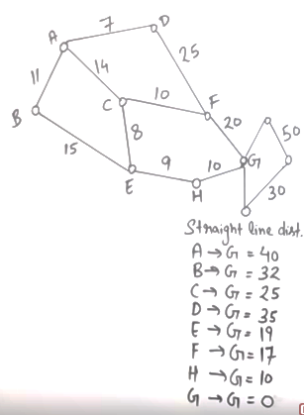
 | Frontier (Greedy) | Expand | Explored
1 | (A,40) | A | Empty
2 | (A-B,32)(A-C,25)(A-D,35) | C | A
3 | (A-B,32)(A-D,35) (A-C-E,19)(A-C-F,17) | F | A,C
4 | (A-B,32)(A-D,35) (A-C-E,19)(A-C-F-G,0) | G | A,C,F
5 | (A-C-F-G,0) Goal Found

Slide 42
 | Frontier (Greedy) | Expand | Explored
1 | (A,40) | A | Empty
2 | (A-C,25) (A-B,32)(A-D,35) | C | A
3 | (A-B,32)(A-D,35)(A-C-F,17)(A-C-E,19) | F | A,C
4 | (A-B,32)(A-D,35)(A-C-F-G,0)(A-C-E,19) | G | A,C,F
5 | (A-C-F-G) Goal Found |  | A,C,F,G
 | Frontier (UCS) | Expand | Explored
1 | (A,0) | A
2 | (A-B,11)(A-C,14)(A-D,7) | D | A
3 | (A-B,11)(A-C,14)(A-D-F,32) | B | A,D
4 | (A-B-E,26)(A-C,14)(A-D-F,32) | C | A,D,B
5 | (A-B-E,26)(A-C-F,24)(A-C-E,22)(A-D-F,32) | E | A,D,B,C
6 | (A-B-E,26)(A-C-F,24)(A-C-E-H,31)(A-D-F,32) | F | A,D,B,C,E
7 | (A-B-E,26)(A-C-F-G,44)(A-C-E-H,31)(A-D-F,32) |  | A,D,B,C,E,F
8 | (A-B-E,26)(A-C-F-G,44)(A-C-E-H,31)(A-D-F,32) | H | A,D,B,C,E,F
9 | A-C-E-H-G,41 Goal Found

